Slide 1

Simply Online
Simple way to connect

Slide 2

Agenda
changed
Team Working Agreement
Personas
Minimal Viable Product (MVP)
Github link
Team Member Roles and Responsiblities
Improvements made from Professor Feedback
Project Description
Technologies
Diagrams
Algorithms
Sprint 4 Recap
Product Backlog
Sprint 5 Backlog
Metrics
Retrospective
Sprint 6
Project Demo – Sprint 5
Live Application Demo
Agenda

Slide 3

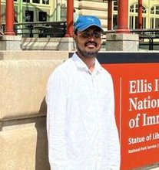
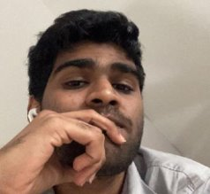
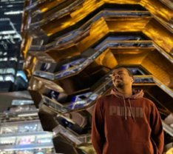
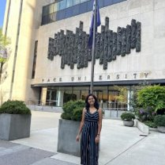

TEAM MEMBERS
Ajay Kumar
Full Stack Developer
Amarendra Reddy
Developer
Pruthvi Raj Reddy
Database Administrator
Mounik
Developer
Sreeja Reddy
Quality Analyst
Ravi Teja Reddy
Developer

Slide 4
Improvement from Professor’s feedback
We incorporated the professor’s feedback and make improvements to the presentation.
Action items in retrospective.
Added the single slide of MVP listing all features and product backlog
API slide is added in the presentation
Average velocity chart in Metrics

Slide 5

Project Description
changed
Simply Online is a web application that aims to simplify the process of online classes. This application allows lecturers to create virtual rooms and share the room id with their students for seamless connectivity. Using webRTC technology, simply online allows group video-sharing features and screen-sharing capabilities. This application allows lecturers to easily take attendance with just a click of a button. This platform includes features like automatic attendance marking and auto transcript generation to eliminate the need for manual tracking and notes taking. Overall, simply online offers a comprehensive and user-friendly solution for educators and students to enhance their online learning experience.

Slide 6
Team Working Agreement
Participation:
All the team members are expected to involve in project discussions and attend the meetings promptly. Absence during multiple meetings will affect the team’s performance and efficiency.
The team member can discuss beforehand with the team leader if he/she is going to miss the meeting or make it up for it before the next meeting is scheduled.
Communication:
The team will communicate with each other using WhatsApp group and meetings will be scheduled on Zoom.
Jira software will be used to track the assigned tasks. For any dependency on another task, mention it in the task comments.
Task management, bugs, sprint planning, and meeting minutes will be tracked in Jira.
To share the final deliverables, Google docs will be used where all the team members can edit the document.
Work Division:
The entire project work should be divided into equal parts, and equal responsibilities should be given to all the team members.
Each team member should complete their division of work before the deadline. If they are unable to complete the work on time, that hinders the performance of the entire team. If in case a team member is facing trouble and issues at some point, they can share it with others so that they can help each other and complete the work before the deadline.
Meetings:
All the team members will meet on zoom virtually every Tuesday and Friday. All the team members must be present, as attendance is mandatory unless there is an exceptional case.
The team leader would be responsible for sending meeting details and conducting the meeting.
A meeting track or meeting minutes report would be listed after every meeting to keep track of the project and its progress.
Every team member is expected to come up with ideas, participate in the discussion, and give an update on their progress for their part of the work.
TEAM MEMBERS
AJAY KUMAR
AMARENDAR
RAVI TEJA
SREEJA
PRUTHVI RAJ
MOUNIK

Slide 7
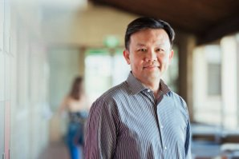
Persona
Name: Professor James​
Age: 45​
Occupation: University Professor​
Profile:
James is a tenured professor in the Computer Science department at a large university. He teaches both undergraduate and graduate-level courses and conducts research in his field. Due to the COVID-19 pandemic, his classes have been moved online, and he uses various platforms to deliver lectures, holds office hours, and communicate with his students. He lives with his spouse and two children, who are also attending school virtually.
Goals and Motivations:
Deliver high-quality lectures and course material to his students Engage his students and create a dynamic and interactive virtual classroom environment.
Ensure that his students are keeping up with the coursework and meeting their learning objectives.
Provide effective feedback and support to his students.

Slide 8

Persona
Name: Sarah
Age: 24
Occupation: College student
Profile:
Sarah is a full-time student pursuing a degree in psychology. Due to the COVID-19 pandemic, her classes have been moved online, and she uses Zoom to attend lectures, participate in group discussions, and communicate with her professors and classmates.
She lives in a small apartment with roommates and shares a room with one of them.
She has a busy schedule and often has to balance her coursework with a part-time job and other responsibilities.
Goals and Motivations:
Attend all her classes and be an active participant in class discussions Stay organized and manage her time effectively to meet assignment deadlines.
Have a reliable and user-friendly platform for attending virtual classes. Connect with her professors and classmates, and build a community within her course

Slide 9

Persona
Name: Ishika
Age: 27
Occupation: Elementary school teacher
Profile:
Ishika is a dedicated elementary school teacher who loves working with children. She has been teaching for three years and is always looking for ways to improve her classroom management and student engagement. Ishika is originally from India but moved to the US with her family when she was a child. She is fluent in English and Hindi and enjoys cooking traditional Indian dishes in her free time
Goals and Motivations:
Ishika is a dedicated elementary school teacher who loves working with children. She has been teaching for three years and is always looking for ways to improve her classroom management and student engagement. Ishika is originally from India but moved to the US with her family when she was a child. She is fluent in English and Hindi and enjoys cooking traditional Indian dishes in her free time
Ishika’s main goal is to create a safe and engaging learning environment for her students. She wants to be able to take attendance quickly and efficiently so she can spend more time teaching and less time on administrative tasks. Sarah is also motivated by the opportunity to track student attendance and identify patterns that might indicate a need for additional support.

Slide 10
MINIMal VIABLE PRODUCT

Slide 11
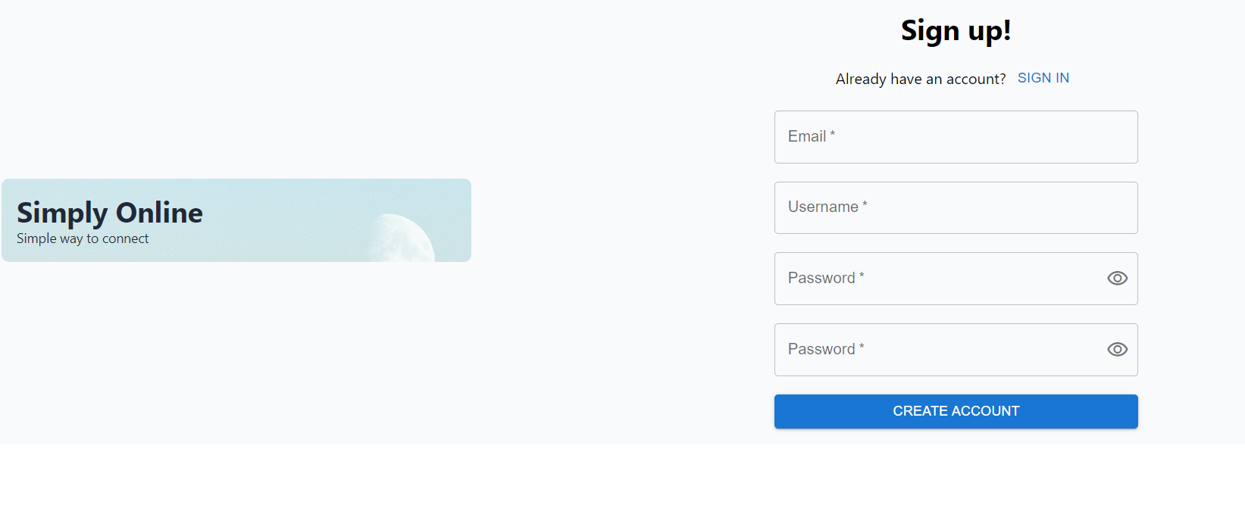
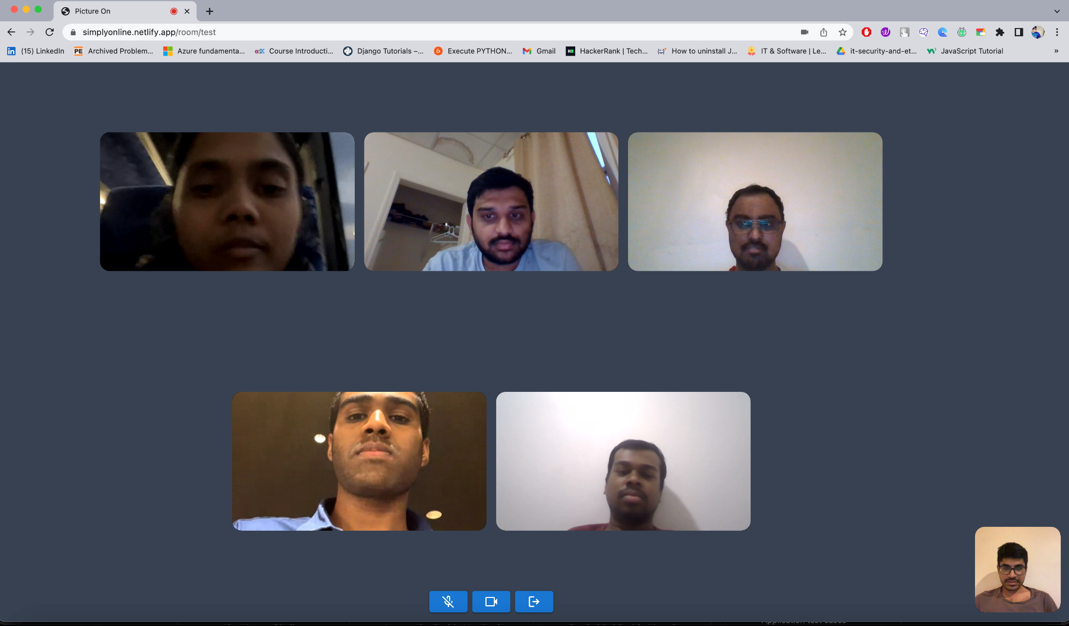
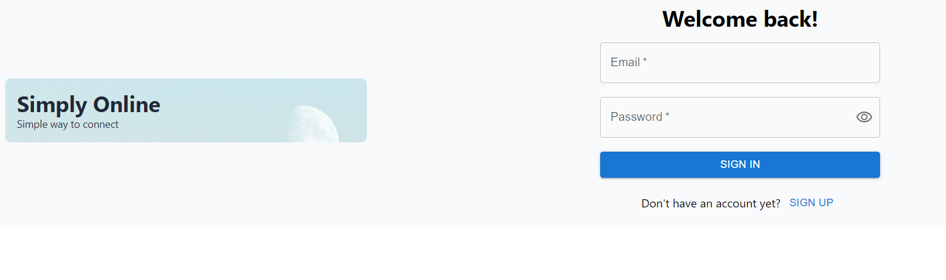
changed

Slide 12
















Technologies

Slide 13
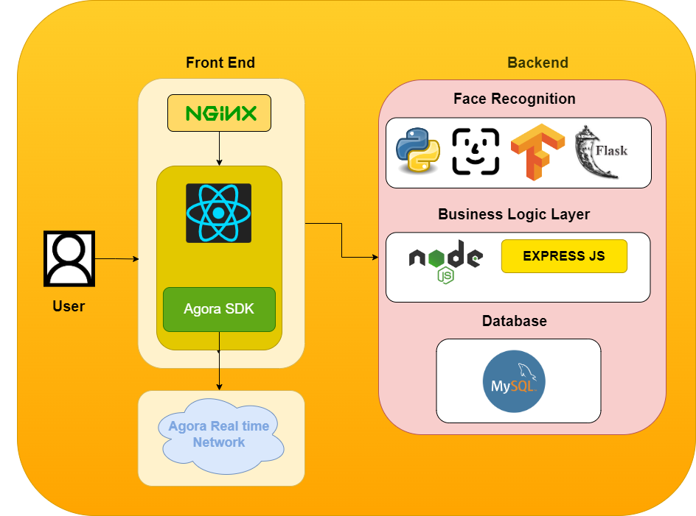
Architecture Diagram

Slide 14
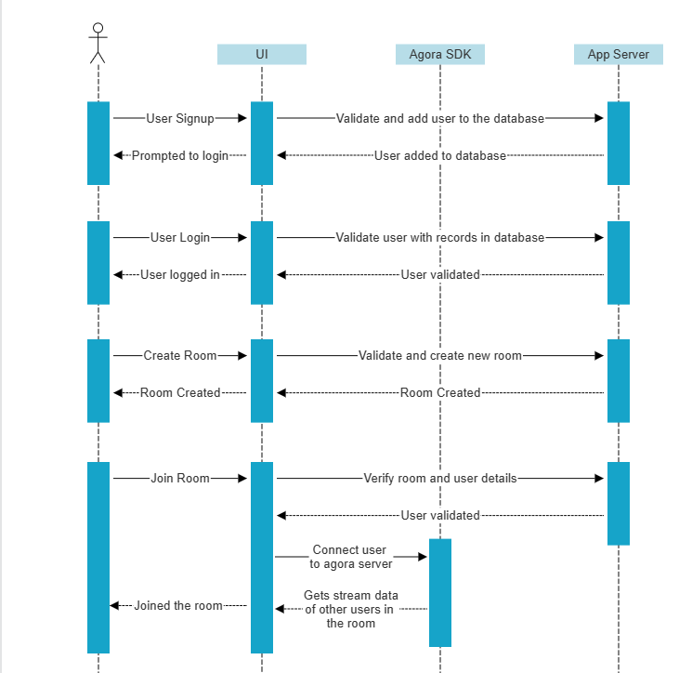
Sequence Diagram
changed

Slide 15
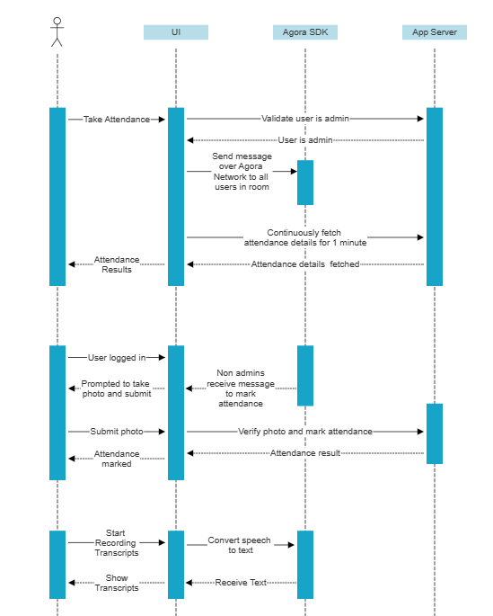
Sequence Diagram
changed

Slide 16
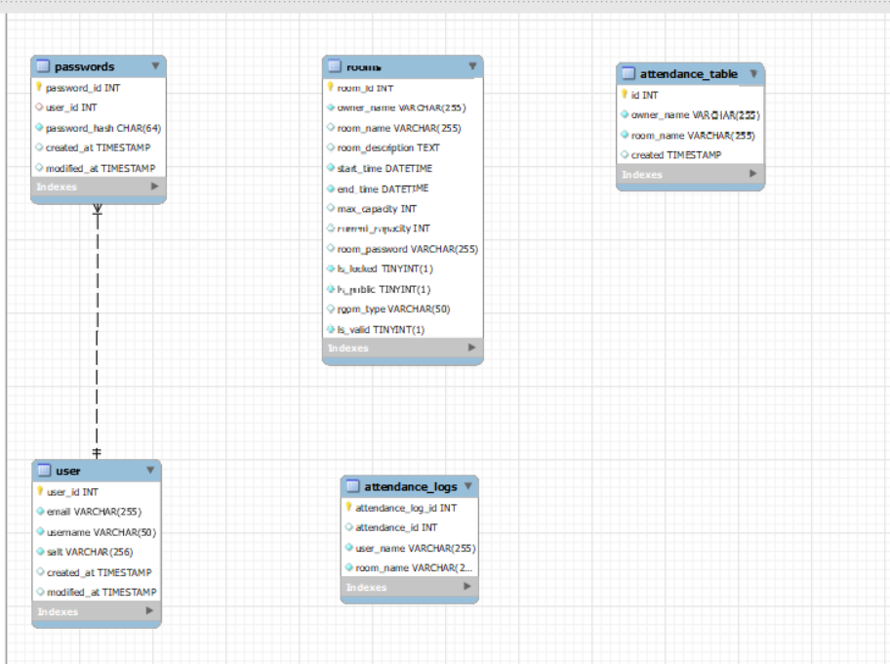
ER Diagram
changed

Slide 17
changed
Sprint-4 Recap
Enable screen sharing feature
Attendance automation using Face recognition

Slide 18
changed
Product backlog &
Acceptance criteria
Userstory | Acceptance Criteria
Create Login and Signup pages | As a user Given user is on the login page. Then user should see username field, password field and login button.
 | As a user Given user is on login page. When user clicks on the signup. Then sign up form should be visible.
 | As a user Given user is on the signup page. Then user should see email field, username field, password field, verify password field and signup button.
Create Tables and stored procedures for authentication | As a user Given user is on the sign up page. When the user enters username And the user enters email And the user enters password And the user clicks on signup Then user should see the message "Registered Successfully"
 | As a user Given user is on login page When user enters username And user enters password And user clicks on Login button Then user should be logged into the application

Slide 19
changed
Product backlog &
Acceptance criteria
User Story | Acceptance Criteria
Create APIs for user signup and login | As a developer Given Host consumes APIs When Host provides proper input to the APIs Then API should validate user AND respond with proper response
Implement Backend authentication using JWT token | As a developer Given Host is consuming login API When Host calls API with email and password Then Backend should return with JWT token if user credentials are valid
Integration of authentication with existing application | As a user Given Host is logged in And Host is on Home page When user tries to access the application Then details should be fetched based on JWT token

Slide 20
changed
Product backlog &
Acceptance criteria
User Story | Acceptance Criteria
Deploy whole application on a public server | As a user Given Host connected to internet When Host goes to URL https://simplyonline.com Then Host should access the simply online application
Group chat | As a user Given Host is in online room When Host clicks on chat icon Then Host should see group chat And Host should be able to send message to group
Transcripts | As a user Given Host is in online room When Host clicks on transcripts icon Then Host should see live captions
Screenshare feature | As an admin Given Host is in online room When Host clicks on screenshare icon Then Host should share his screen to whole room

Slide 21
changed
Sprint 5 backlog
STORY ID | USER STORY | STORY POINTS
SIM-42 | Create login and signup pages | 8
SIM-43 | create tables and stored procedures for authentication | 8
SIM-45 | implement backend authentication using JWT token | 13
SIM -44 | create API's for user signup and login | 13
SIM-47 | testing login and signup features | 13
SIM-46 | integration of authentication with existing application | 5

Slide 22
changed
Test Cases
Unit to test​ | Scenario​ | Expected Result​
Sign up user | User provides valid inputs | User will be signed up and will be redirected to login page
Sign up user | User provides invalid email format | Error should be shown to user that email is not valid
Signup user | User provides invalid password | Error should be shown to user that password is not valid or passwords does not match
Login | User provides valid credentials | User should be logged in and redirected to home page
Login | User provides invalid credentials | User should see an error message that credentials are not valid
API validations | Call APIs with wrong inputs | Same errors should be thrown from backend

Slide 23
changed
STORY ID​ | USER STORY​ | STORY POINTS​ | Status​
SIM-42 | Create login and signup pages | 8 | Done​
SIM-43 | create tables and stored procedures for authentication | 8 | Done​
SIM-45 | implement backend authentication using JWT token | 13 | Done​
SIM -44 | create API's for user signup and login | 13 | Done​
SIM-47 | testing login and signup features | 13 | Done​
SIM-46 | integration of authentication with existing application | 5 | Done​
Completed and not completed tasks

Slide 24
Metrics

Slide 25
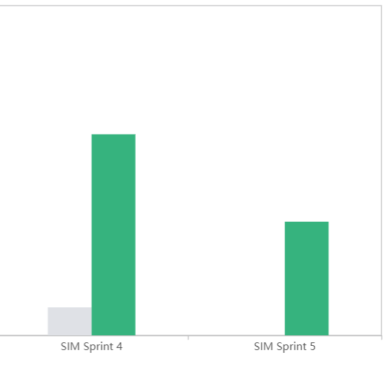
Team Velocity Report
changed

Slide 26
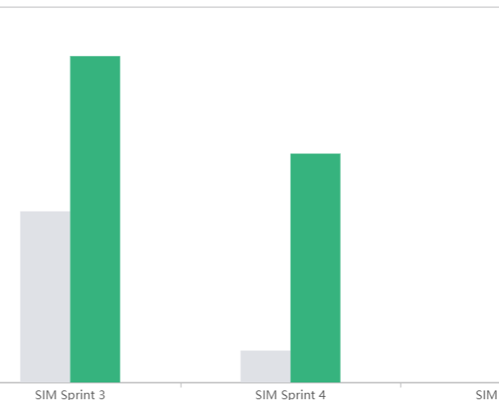
Team Historical Velocity Report
changed

Slide 27
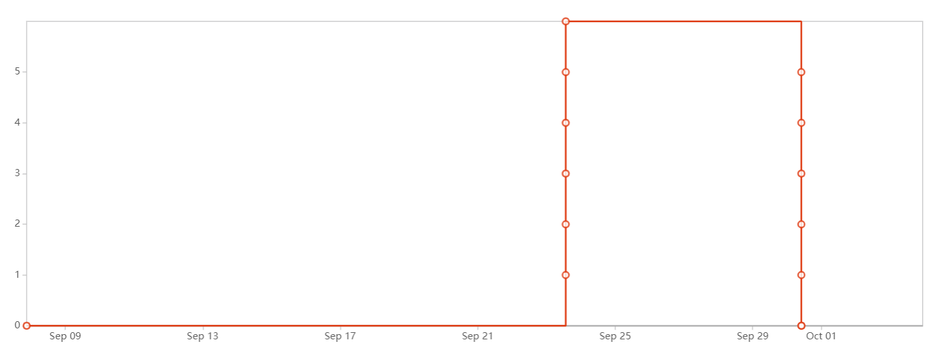
Sprint Burndown Chart

Slide 28
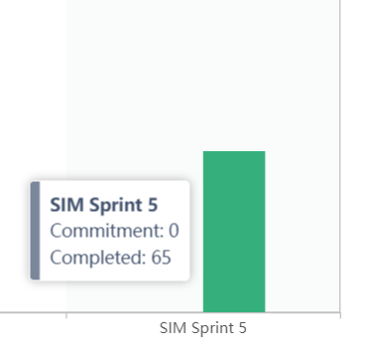
Committed and Completed Ratio
changed

Slide 29
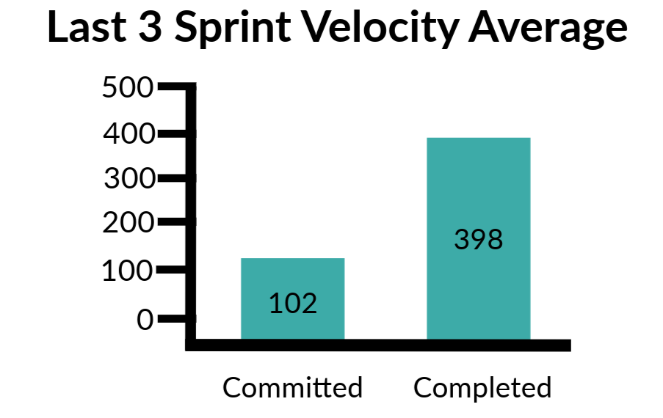
Average Velocity

Slide 30
Retrospective
What went well:
Team successfully completed all the planned user stories or tasks during sprint
Team's ability to quickly identify and resolve issues, blockers, or impediments during the sprint
What didn’t go well:
Sprint planning didn't go well at the beginning and this made it difficult to allocate resources effectively.
Action Steps:
Break down user stories and tasks into smaller, manageable sub-tasks.
Clearly define sprint goals, tasks, and priorities. Conduct regular meetings to track the sprint progress

Slide 31
changed
Sprint 6
STORY ID​ | USER STORY​ | STORY POINTS​
SIM-21 | Enable screen sharing feature | 20​
SIM-39 | Mark Attendance feature production deployment | 40
SIM-40 | Test live application with many users | 20
SIM-49 | Deploy application on public server | 40
SIM-48 | Add transcript functionality | 30

Slide 32

Group call

Slide 34
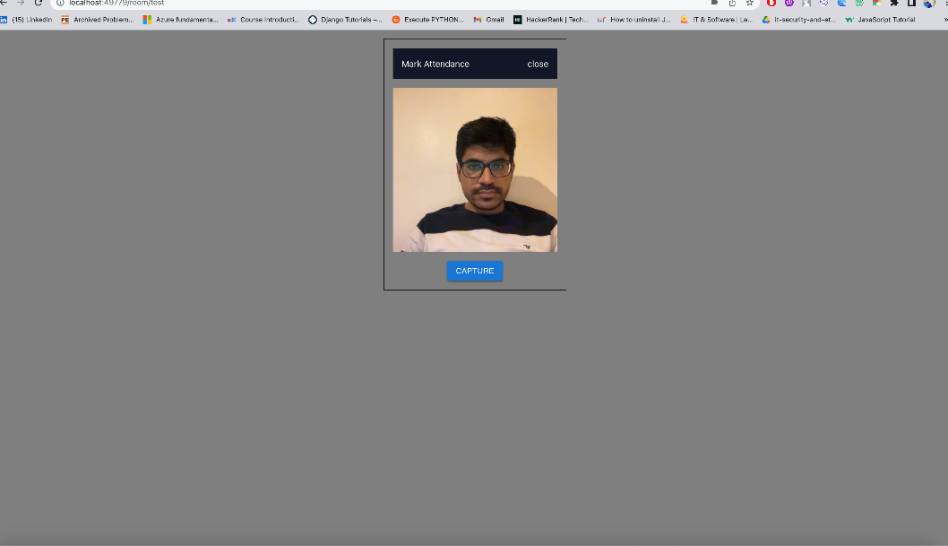
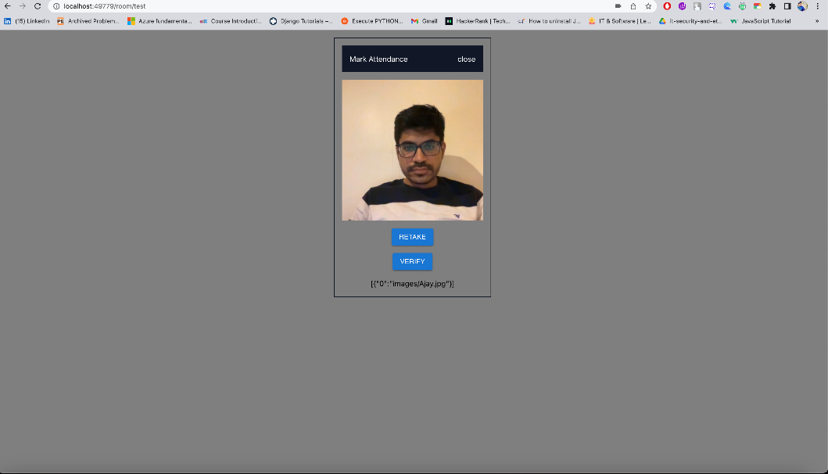
Mark Attendance/verify
This screen allows user to capture the photo and verify that it is the same user or not

Slide 35
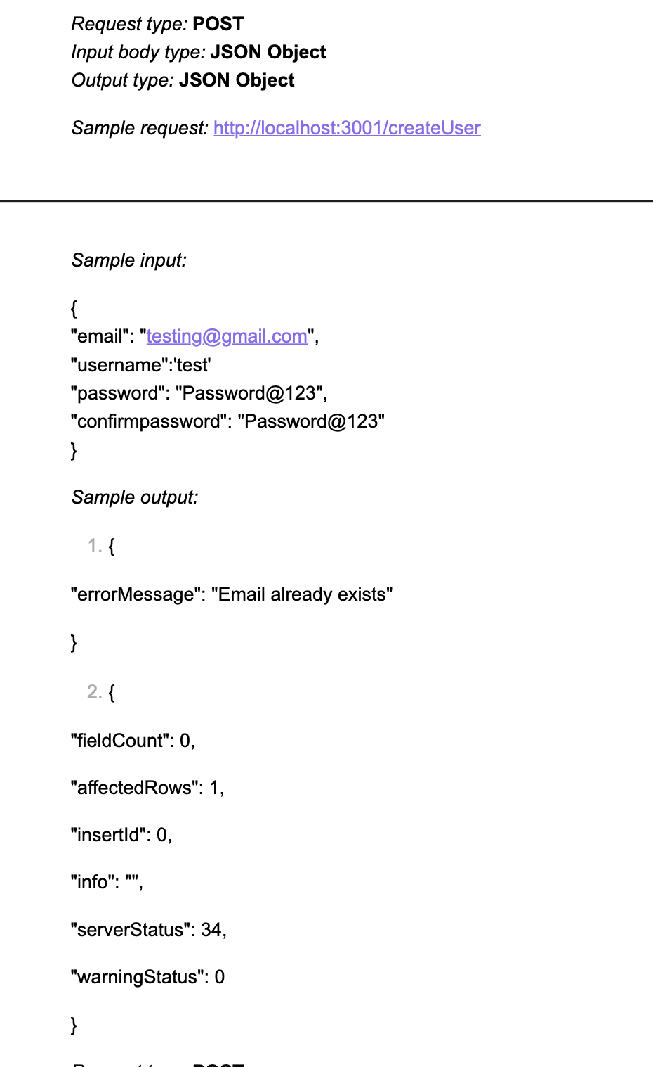
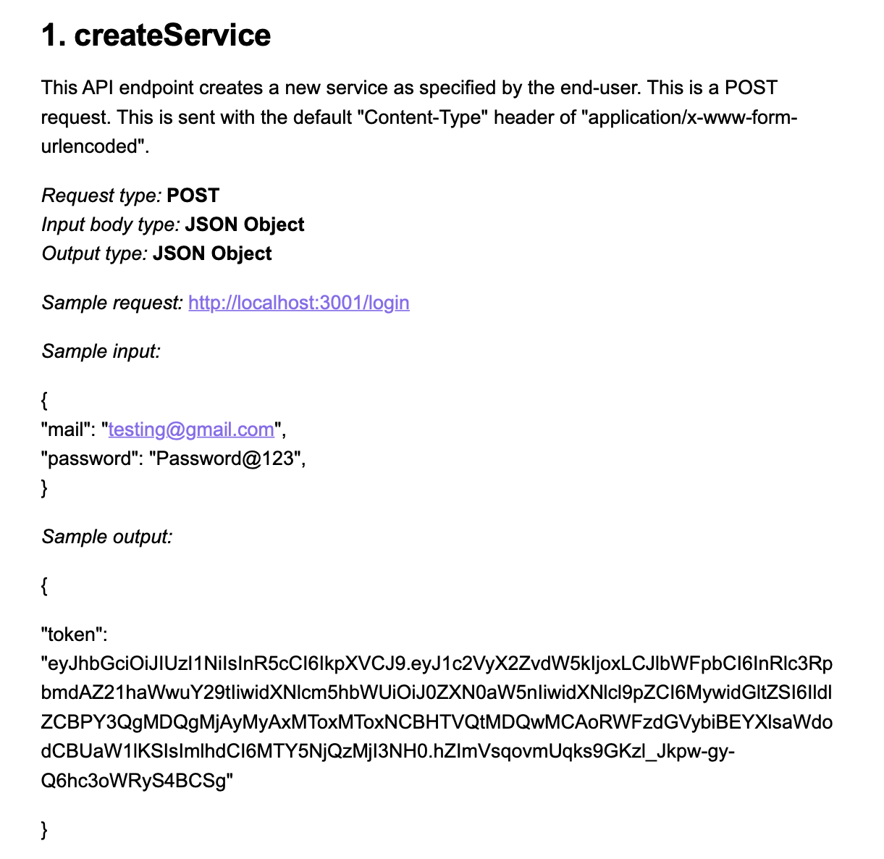
API for login and signup

Slide 36
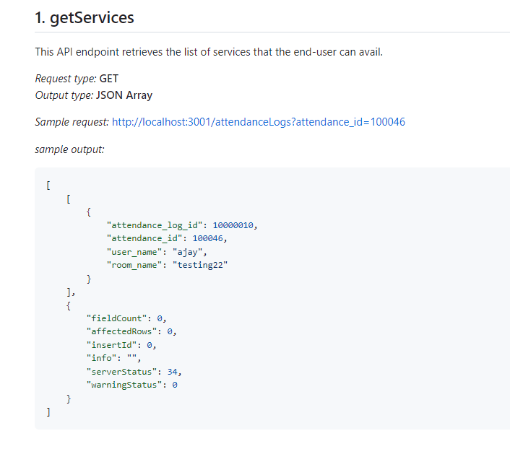
Api’s

Slide 37
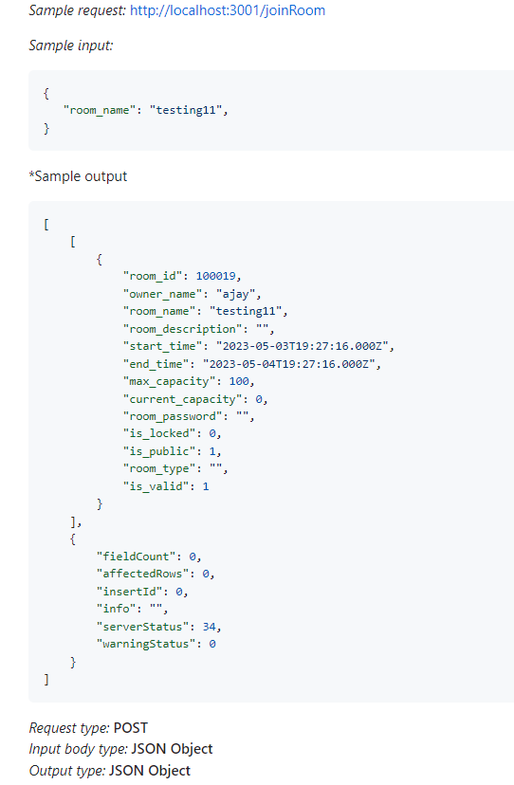
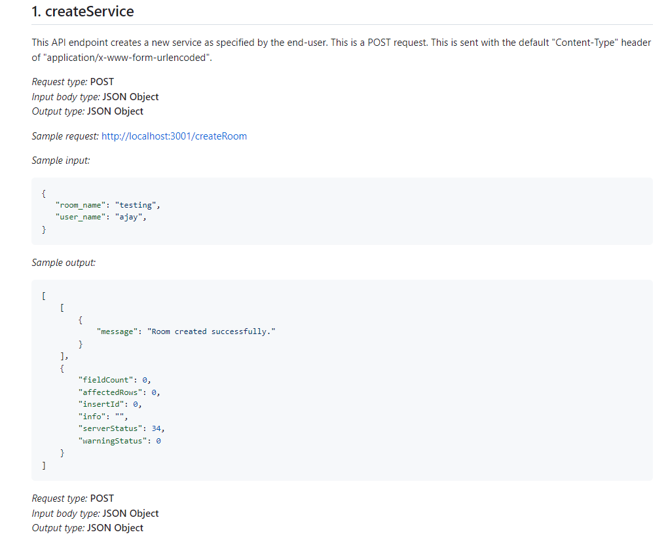
API’s

Slide 38
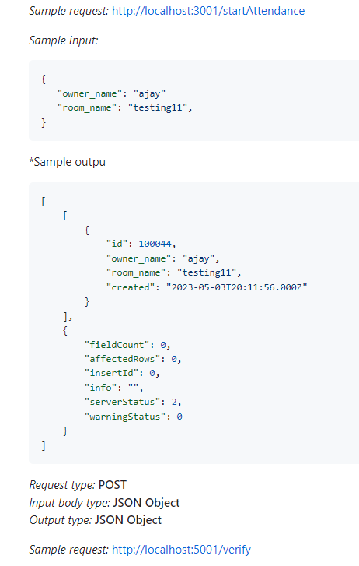
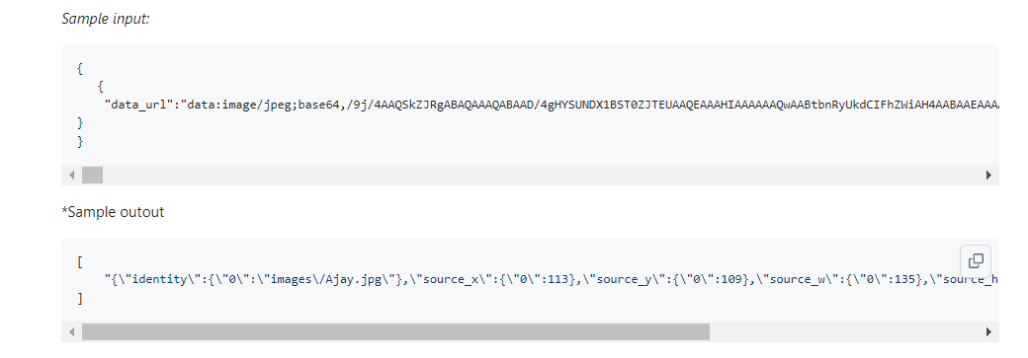
Api’s

Slide 39
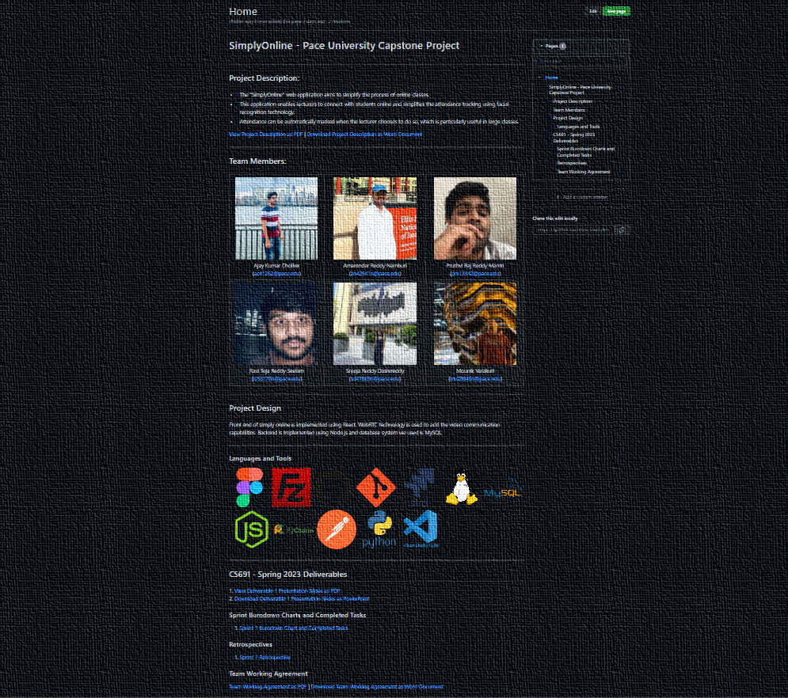
WIKI PAGE
https://github.com/htmw/SimplyOnline/wiki

Slide 40
Demo Link
YouTube

Slide 41
Thank You

